Slide 1
Relational Database Model
Lecture 2

Slide 2
DBMS
Database – a collection of data that is logically coherent.
DBMS – Database Management System
defines, creates, and maintains a database.
Allows users controlled access to data in the database.
A combination of 5 components:
Hardware
Software
Data
Users
Procedures

Slide 3
DBMS components
Hardware – the physical computer system that allows physical access to data.
Software – the actual program that allows users to access, maintain, and update physical data.
Data – stored physically on the storage devices
Users –
End users - Normal user and DBA (Database Administrator)
Application programs
Procedures – a set of rules that should be clearly defined and followed by the users.

Slide 4
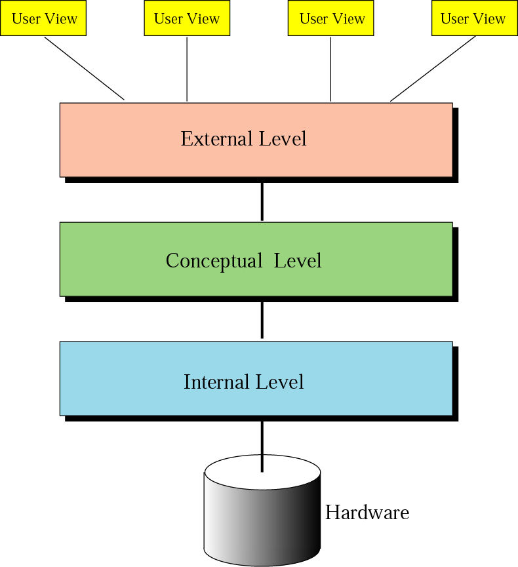
Database architecture

Slide 5
Database architecture
Internal level –
Determines where data are actually stored on the storage device.
Low-level access method
Conceptual level –
Defines the logical view of the data
The main functions of DBMS are in this level.
External level –
Interacts directly with the user.
Change the data coming from the conceptual level to a format and view that are familiar to the users.

Slide 6
Internal/Physical Level
Physical schema describes details of how data is stored: tracks, cylinders, indices etc.
Early applications worked at this level - explicitly dealt with details.
Problems:
Routines hardcoded to deal with physical representation.
Changes to data structure difficult to make.
Application code becomes complex since it must deal with details.
Rapid implementation of new features impossible.

Slide 7
Conceptual Level
Hides details.
In the relational model, the conceptual schema presents data as a set of tables.
DBMS maps from conceptual to physical schema automatically.
Physical schema can be changed without changing application:
DBMS must change mapping from conceptual to physical.
Referred to as physical data independence.

Slide 8
External Level
In the relational model, the external schema also presents data as a set of relations.
An external schema specifies a view of the data in terms of the conceptual level. It is tailored to the needs of a particular category of users.
Portions of stored data should not be seen by some users.
Students should not see faculty salaries.
Faculty should not see billing data.
Information that can be derived from stored data might be viewed as if it were stored.
GPA not stored, calculated when needed.

Slide 9
Data Model
Schema: description of data at some level (e.g., tables, attributes, constraints, domains)
Model: tools and language for describing:
Conceptual and external schema
Data definition language (DDL)
Integrity constraints, domains (DDL)
Operations on data
Data manipulation language (DML)
Directives that influence the physical schema (affects performance, not semantics)
Storage definition language (SDL)

Slide 10
Database models
A database model
defines the logical design of data.
Describes the relationships between different parts of data.
models
Hierarchical model
Network model
Relational model

Slide 11
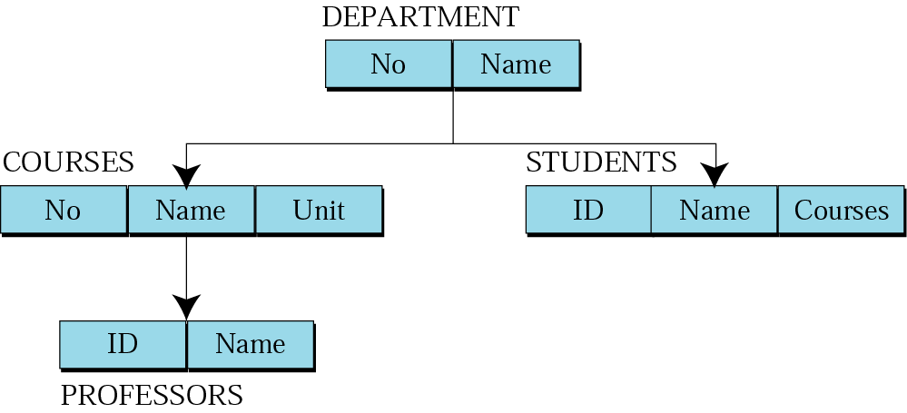
Hierarchical model
Data are organized as an upside down tree.
Each entity has only one parent but can have several children.

Slide 12
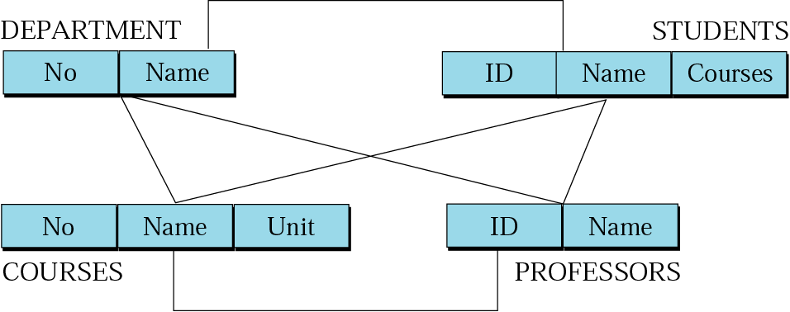
Network model
The entities are organized in a graph.
Some entities can be accessed through several paths.

Slide 13
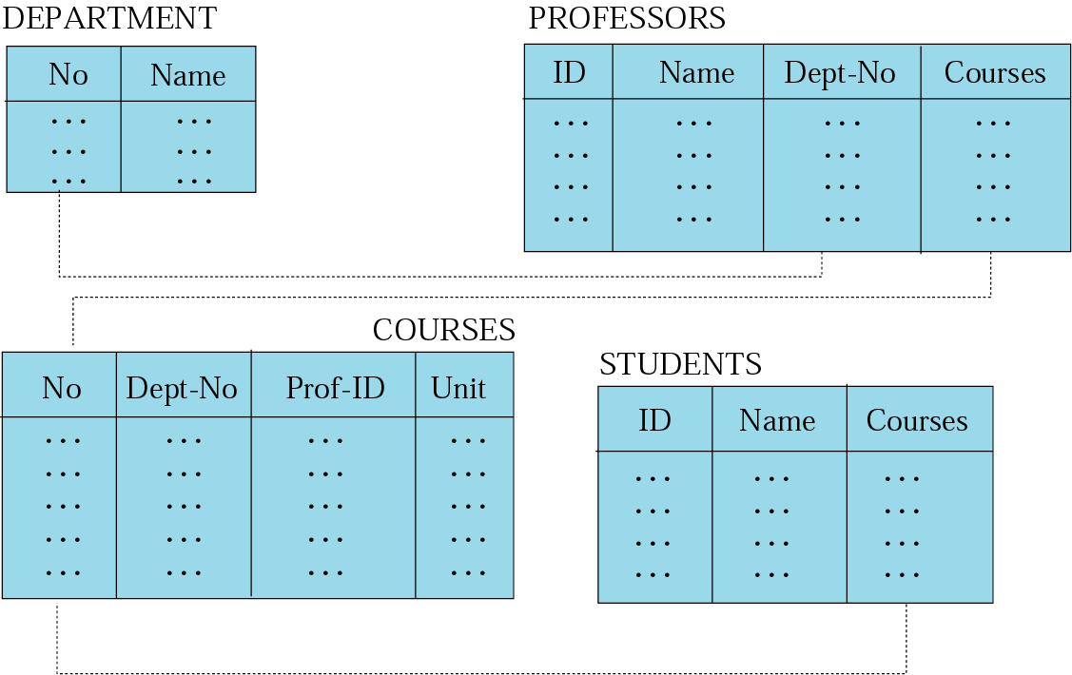
Relational model
Data are organized in two-dimensional tables called relations.
The tables are related to each other.
The most popular model.

Slide 14
Relational model
RDBMS (Relational Database Management System)
External view:
The data are represented as a set of relations.
A relation is a two-dimensional table.
This doesn’t mean that data are stored as tables; the physical storage of the data is independent of the way the data are logically organized.

Slide 15
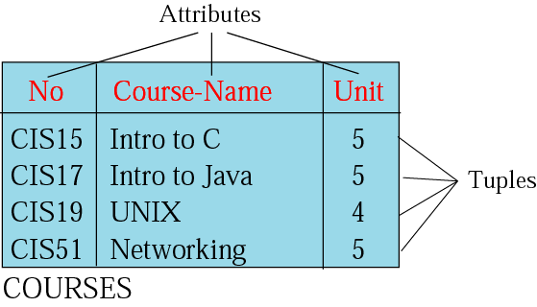
Relation
Name – each relation in a relational database should have a name that is unique among other relations.
Attribute – each column in a relation.
The degree of the relation – the total number of attributes for a relation.
Tuple – each row in a relation.
The cardinality of the relation – the total number of rows in a relation.

Slide 16
Relation Schema
Relation name
Attribute names and domains
Integrity constraints - e.g.,:
The values of a particular attribute in all tuples are unique
The values of a particular attribute in all tuples are greater than 0
Default values

Slide 17
Integrity Constraints
Part of schema
Restriction on state (or sequence of states) of database
Enforced by DBMS
Intra-relational - involve only one relation
Part of relation schema
e.g., all Ids are unique
Inter-relational - involve several relations
Part of relation schema or database schema

Slide 18
Kinds of Integrity Constraints
Static - limitation on state of database
Syntactic (structural)
e.g., all values in a column must be unique
Semantic (involve meaning of attributes)
e.g., cannot register for more than 18 credits
Dynamic - limitation on sequence of database states (supported by some DBMSs, but not in current SQL standard)
e.g., cannot raise salary by more than 5%

Slide 19
Key Constraint
Values in a column (or columns) of a relation are unique: at most one row in a relation instance can contain a particular value(s)
Key - set of attributes satisfying key constraint
e.g., Id in Student,
e.g., (StudId, CrsCode, Semester) in Transcript

Slide 20
Key Constraint (con’t)
Minimality - no subset of a key is a key
(StudId, CrsCode) is not a key of Transcript
Superkey - set of attributes containing key
(Id, Name) is a superkey of Student
Every relation has a key
Relation can have several keys:
primary key (Id in Student) – (cannot be null)
candidate key ((Name, Address) in Student)

Slide 21
Foreign Key Constraint
Referential integrity => Item named in one relation must correspond to tuple(s) in another that describes the item
Transcript (CrsCode) references Course(CrsCode )
Professor(DeptId) references Department(DeptId)
a1 is a foreign key of R1 referring to a2 in R2 => if v is a value of a1, there is a unique tuple of R2 in which a2 has value v
This is a special case of referential integrity: a2 must be a candidate key of R2 (CrsCode is a key of Course)
If no row exists in R2 => violation of referential integrity
Not all rows of R2 need to be referenced.: relationship is not symmetric (some course might not be taught)
Value of a foreign key might not be specified (DeptId column of some professor might be null)

Slide 22
Foreign Key Constraint (Example)
a2
v3
v5
v1
v6
v2
v7
v4
a1
v1
v2
v3
v4
--
v3
R1
R2
Foreign key
Candidate key

Slide 23
Foreign Key (con’t)
Names of a1 and a2 need not be the same.
With tables:
ProfId attribute of Teaching references Id attribute of Professor
R1 and R2 need not be distinct.
Employee(Id:INT, MgrId:INT, ….)
Employee(MgrId) references Employee(Id)
Every manager is also an employee and hence has a unique row in Employee
Teaching(CrsCode: COURSES, Sem: SEMESTERS, ProfId: INT)
Professor(Id: INT, Name: STRING, DeptId: DEPTS)

Slide 24
Foreign Key (con’t)
Foreign key might consist of several columns
(CrsCode, Semester) of Transcript references (CrsCode, Sem) of Teaching
R1(a1, …an) references R2(b1, …bn)
There exists a 1 - 1 relationship between a1,…an and b1,…bn
ai and bi have same domains (although not necessarily the same names)
b1,…bn is a candidate key of R2

Slide 25
Semantic Constraints
Domain, primary key, and foreign key are examples of structural (syntactic) constraints
Semantic constraints express rules of application:
e.g., number of registered students ≤ maximum enrollment

